Slide 1

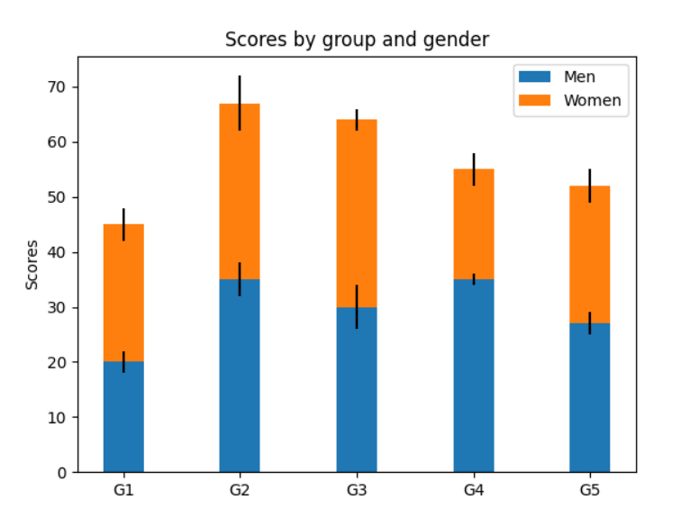
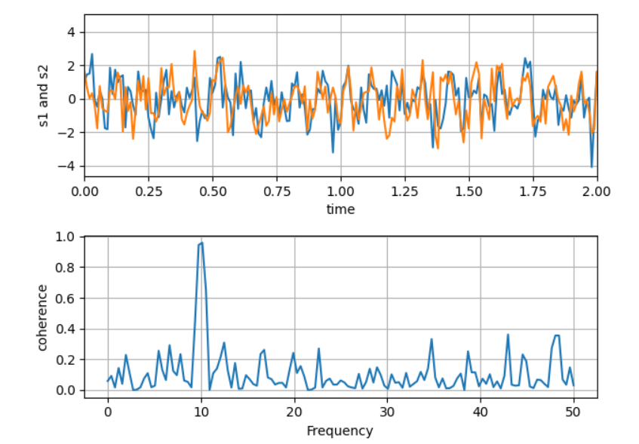
Data Visualization Library
https://matplotlib.org/
Nachiketh

Slide 2
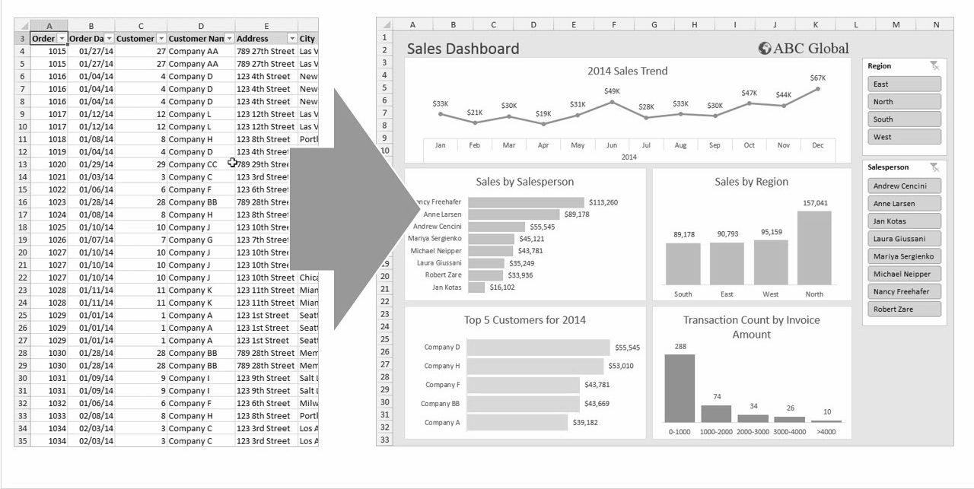
What is Data Visualization ?
Data visualization is the graphical representation of information and data with images.
Notes:
Data Visualization definition
Change → We live in the era

Slide 3

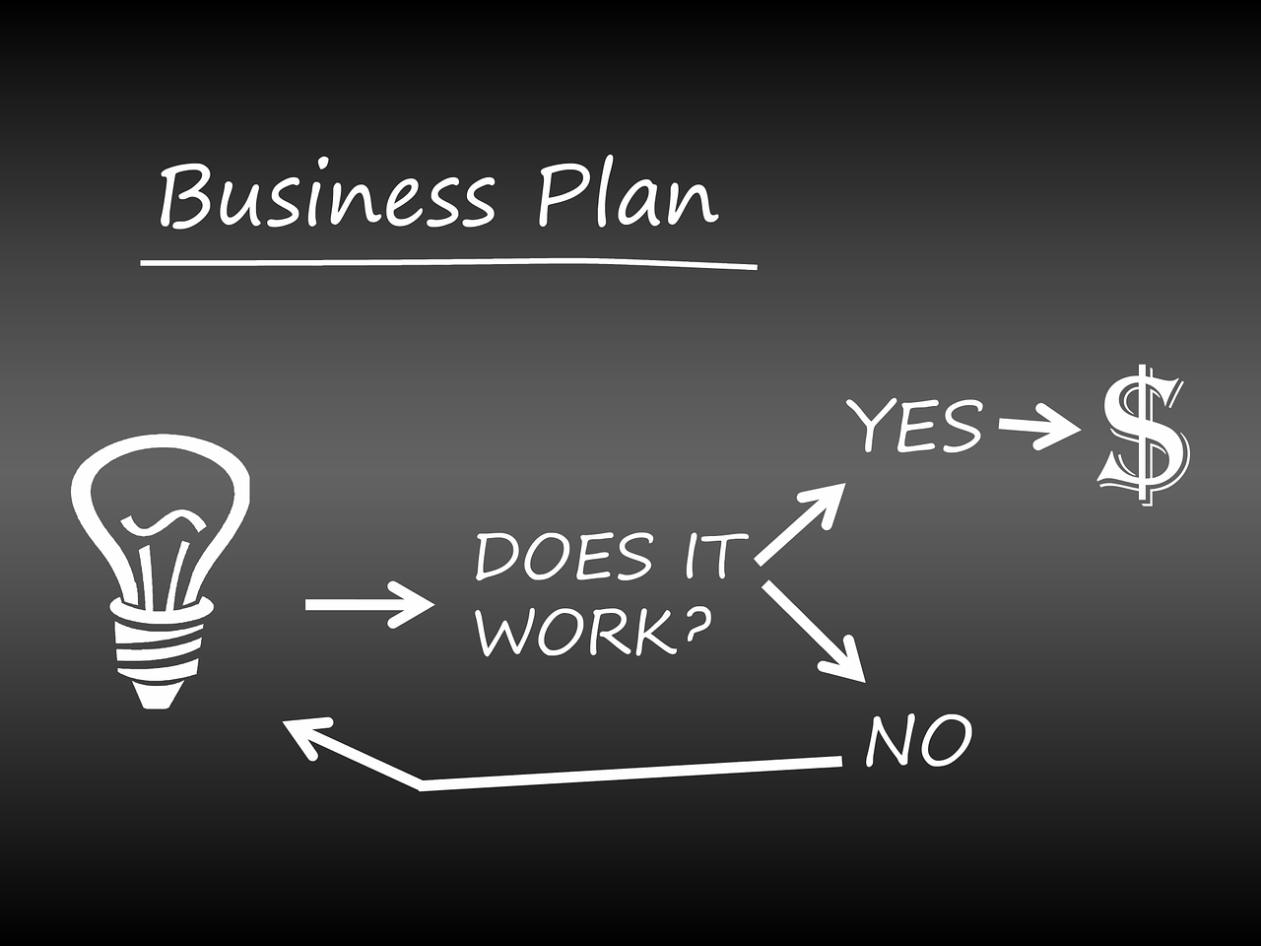


Notes:
This data visualization tools and technologies
Analyze - Bar graoh
Data driven decisions
Lets take up an example

Slide 4

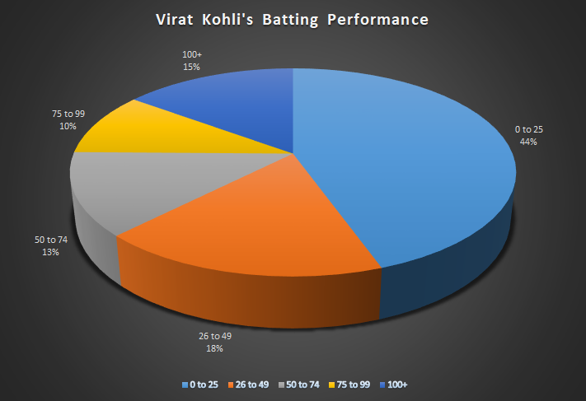

Example for Visualization
Notes:
On the screen
This representing batting performance
And guys, you dont have to feel left out → next slide

Slide 5
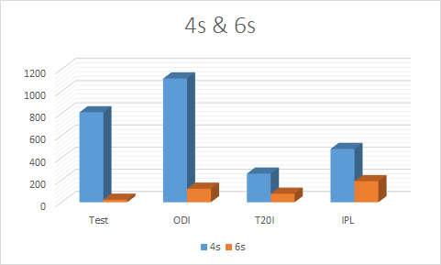
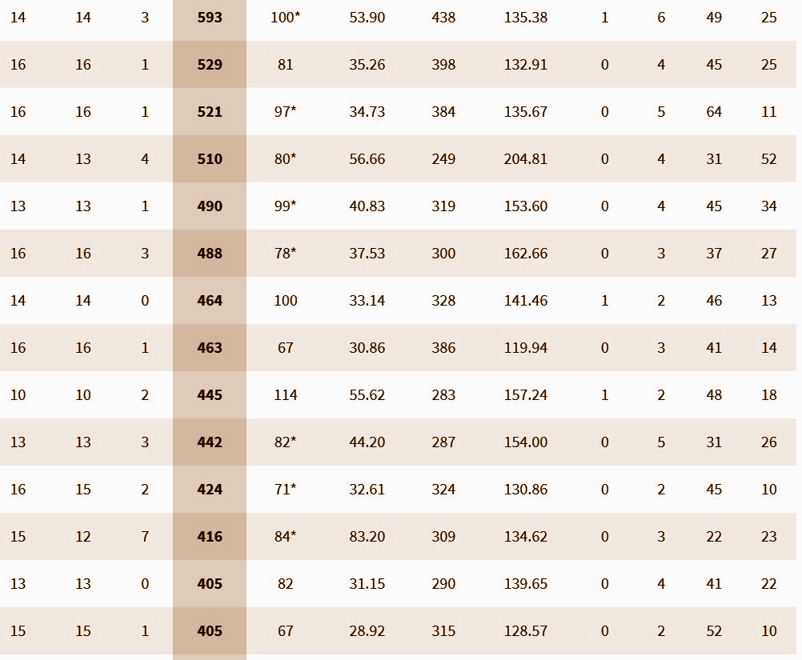
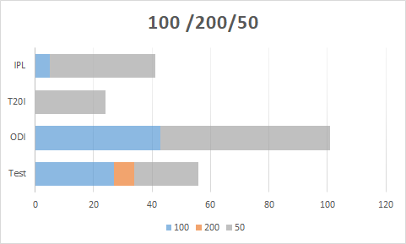
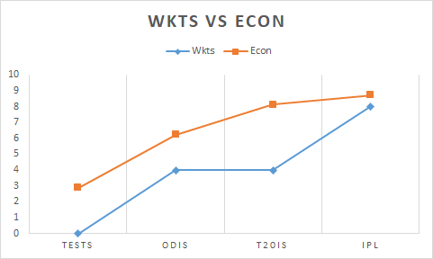
Example for Visualization
Notes:
Simplified and represented - charts one by one
Advantages of data visualization

Slide 6
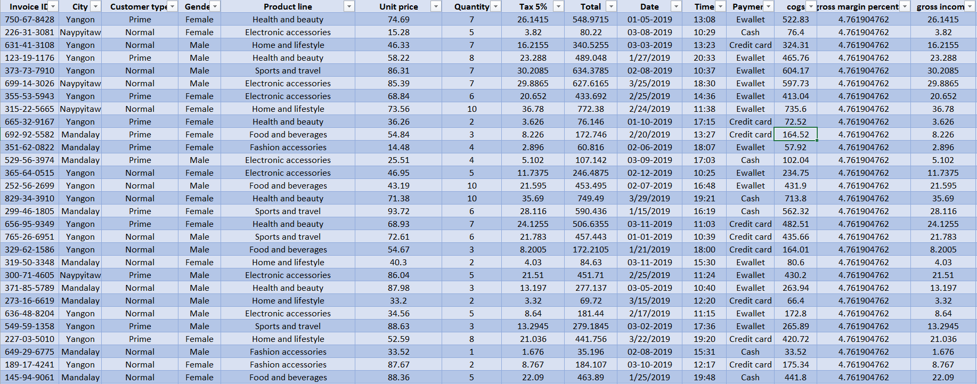
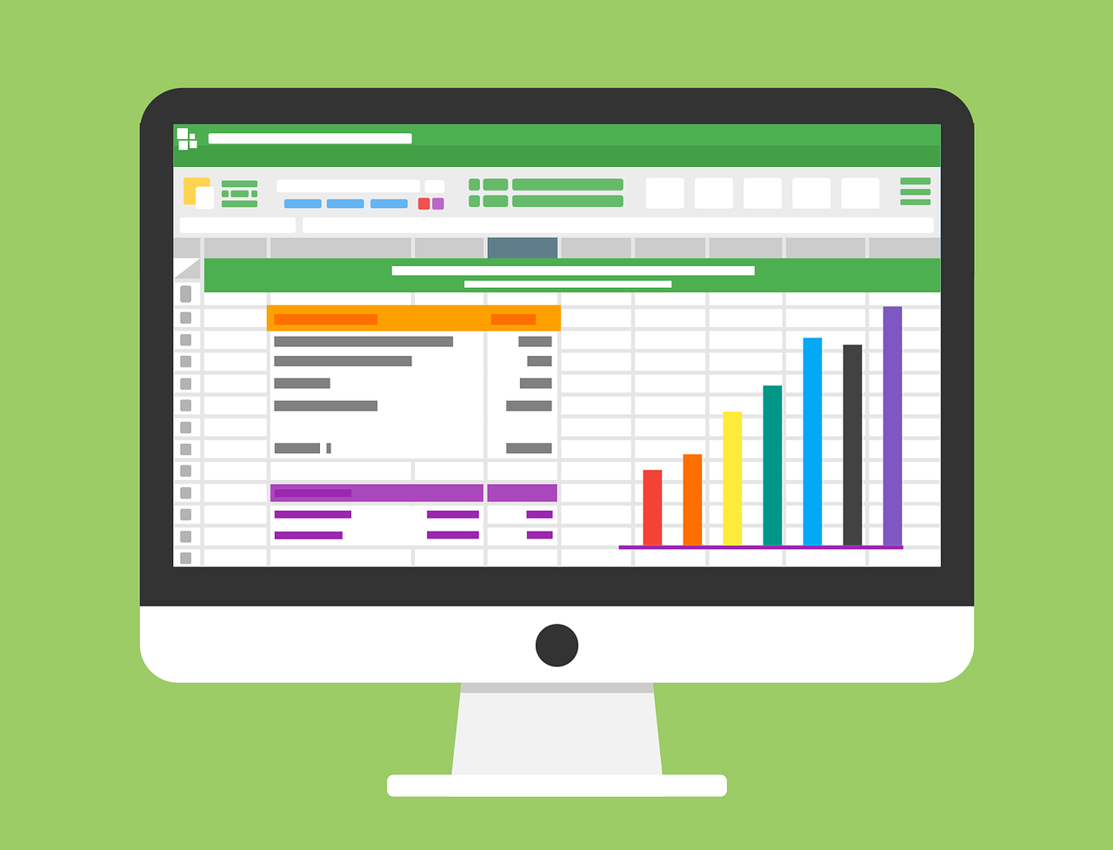


Sales Data
Advantages of Data Visualizations
Notes:
Amazon
Sales data
Excel sheet
That is when → computer image
Data visualation is story telling
Strategy for business

Slide 7
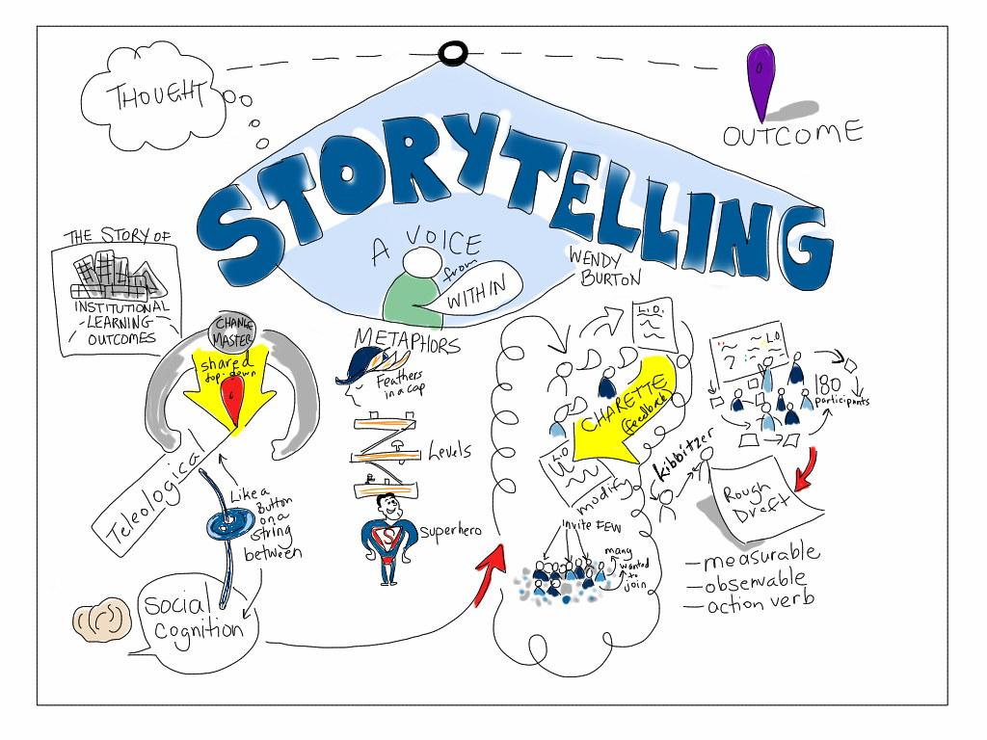
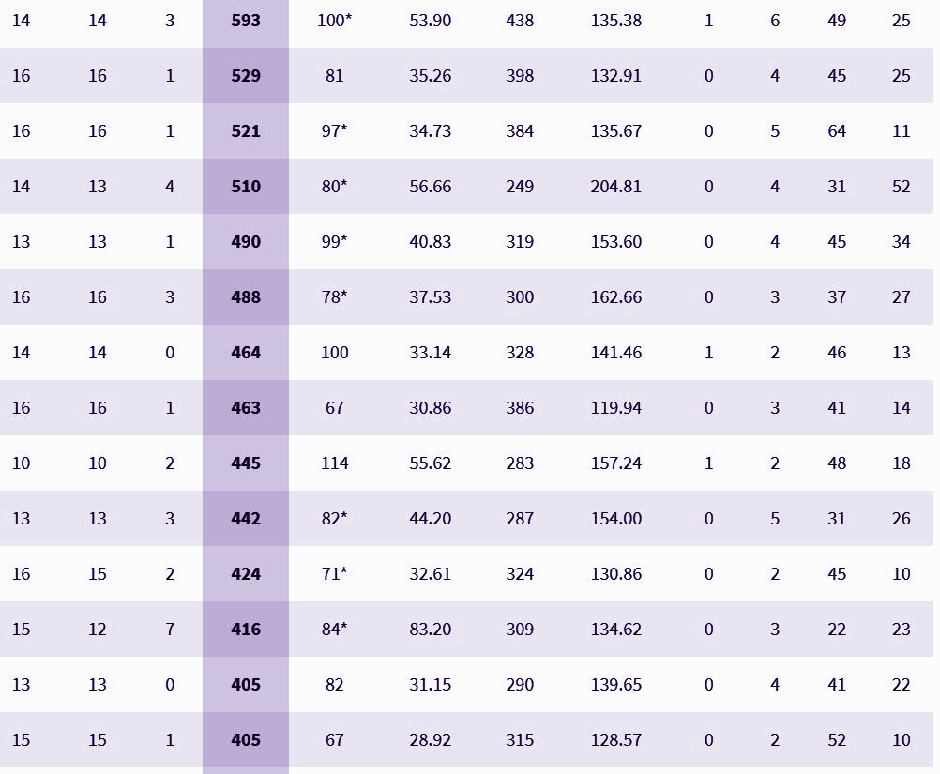
Notes:
Curating the data
Easier to understand
Which leads to..

Slide 8
Advantages of Data Visualization
Better analysis
Quick action
Identifying patterns
Finding errors
Understanding the story
Exploring business insights
Grasping the Latest Trends

Slide 9
What is Matplotlib ?
Matplotlib is a comprehensive library for creating static, animated, and interactive visualizations in Python.
Import Instructions:
import matplotlib as mpl
import matplotlib.pyplot as plt
Installation Instructions:
$pip install matplotlib

Slide 10
Anatomy of a plot
Notes:
Living room

Slide 11



TV Mounted on a Wall
Notes:
Lets put a tv
Tv mounted wall
In the same way

Slide 12
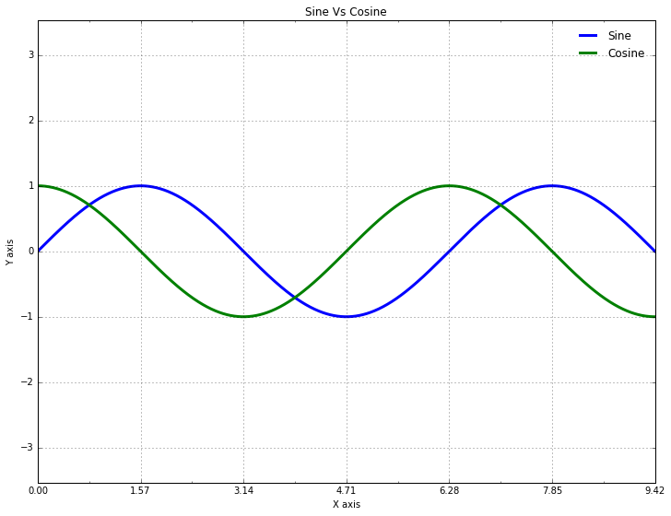
Title of the Plot
Figure
Legend
Y-Axis Label
Axes
Major Tick Label
X-Axis Label
Notes:
Figure
Axes
Title

Slide 13
Figure
Axes : 1
Axes : 2
Notes:
For all plots, we create figure and axes

Slide 14
How to create figure & axes

Slide 15
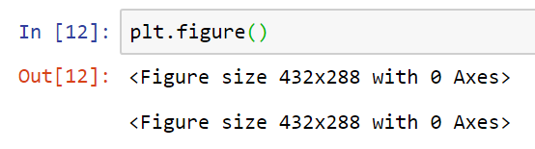
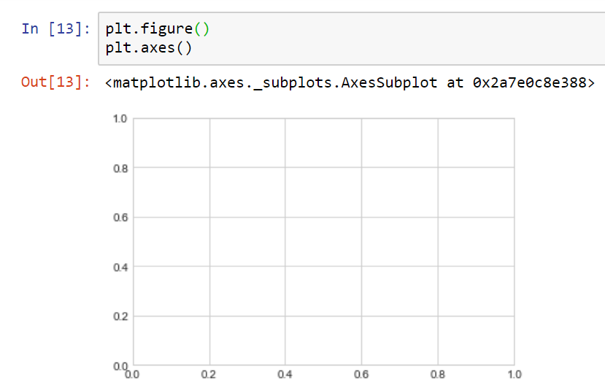
Figure
Figure and Axes
Note:
fig → Refer the figure instance
ax → Refer an axes instance
Empty Gridded axes

Slide 16
Types of Plot

Slide 17
Depending on Data & Application, we can create plots of our interest, using matplotlib
Line Plots
Scatter Plots
Histogram Plots
Bar Chart
Box Plot
Correlation Plot
Heatmap
Violin Plot
Swarm Plot
Pie Chart, etc.

Slide 18
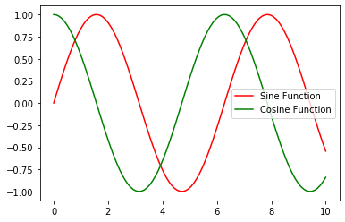
Line Plots

Slide 19
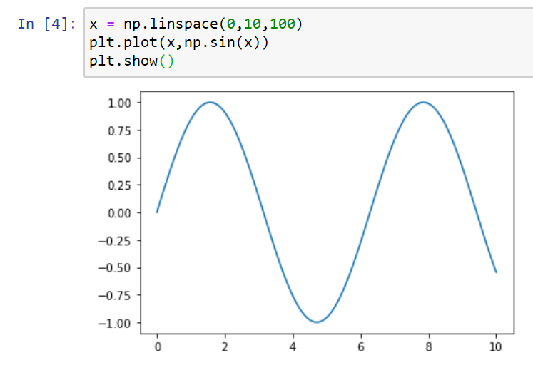
Line Plots

Slide 20
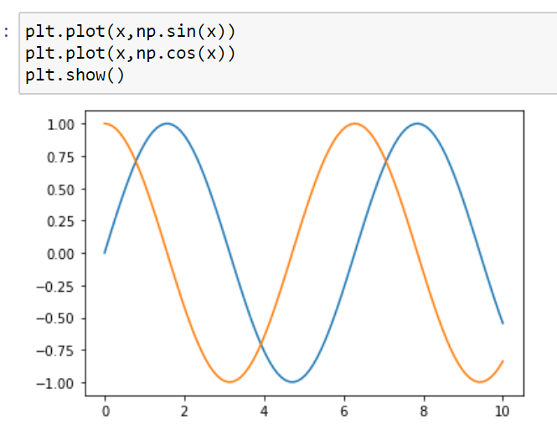
Create Multiple Line Plots in single figure
simply call the plot function multiple times

Slide 21
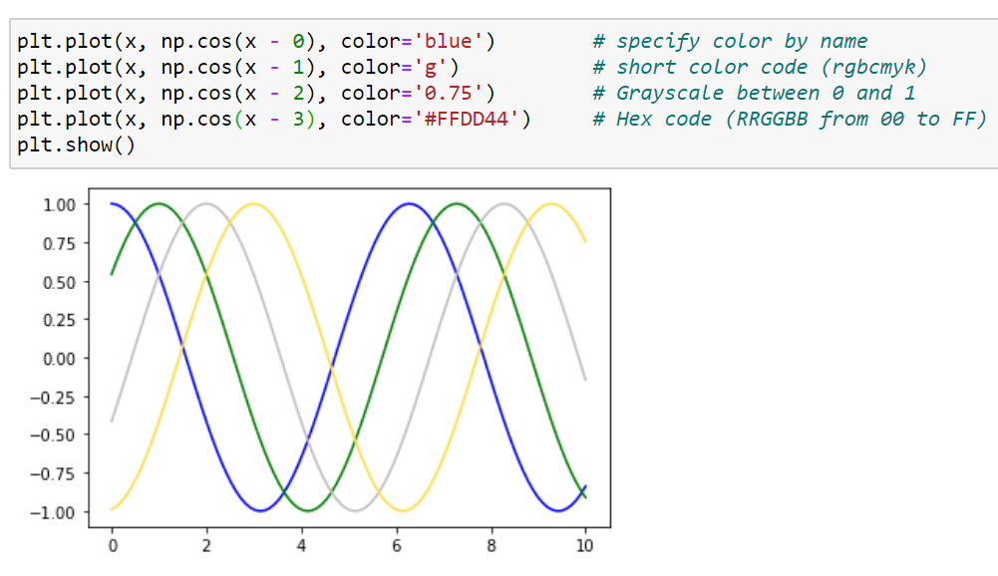
Adjusting the plots : Line Color
Use color keyword inside plt.plot() function

Slide 22
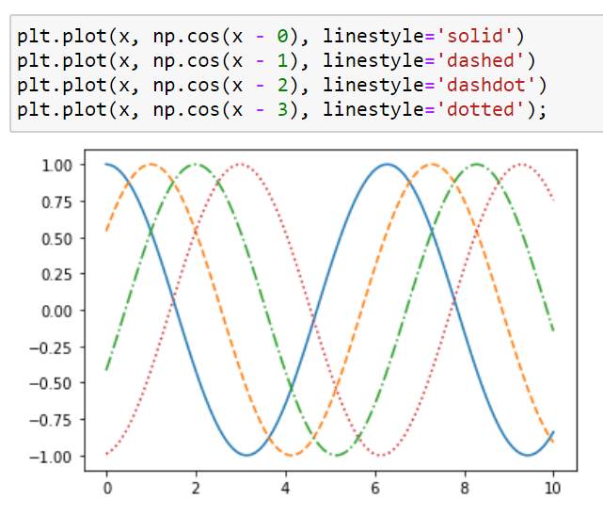
Adjusting line plots : Line Style
Use linestyle keyword to adjust the Line Style

Slide 23
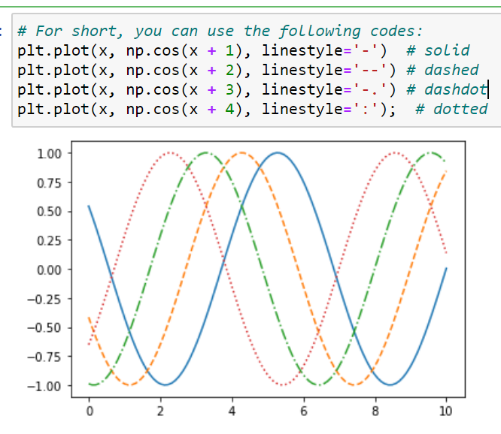
Adjusting line plots : Line Style
Use linestyle keyword to adjust the Line Style

Slide 24
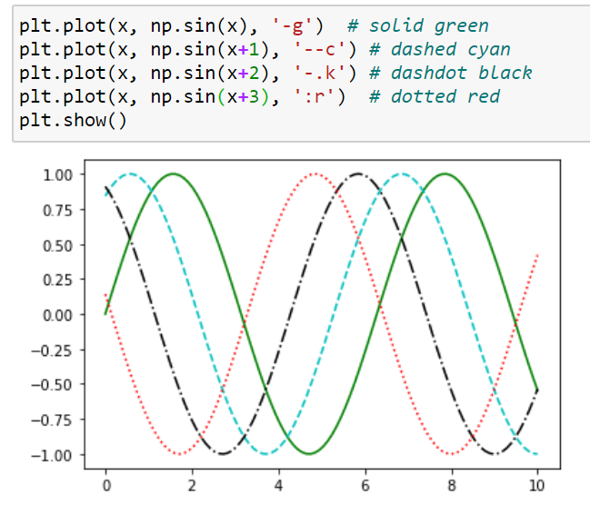
Adjusting Line Plot : Line Style & Color
Line Style & Color can be combined into Single Non-Keyword Argument

Slide 25
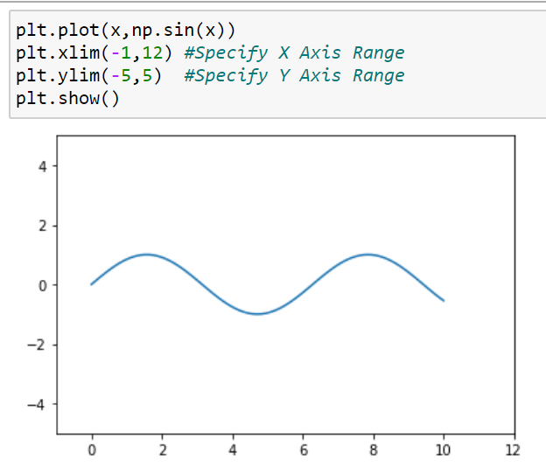
Adjusting Plots:
Axes Limits
Methods:
plt.xlim()
plt.ylim()

Slide 26
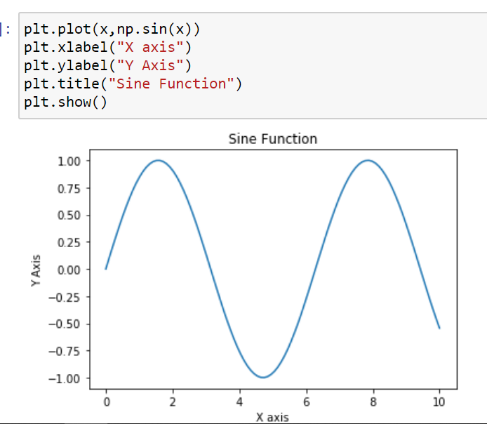
Adjusting Plots:
Labelling Plots
Method:
plt.xlabel()
plt.ylabel()
plt.title()

Slide 27
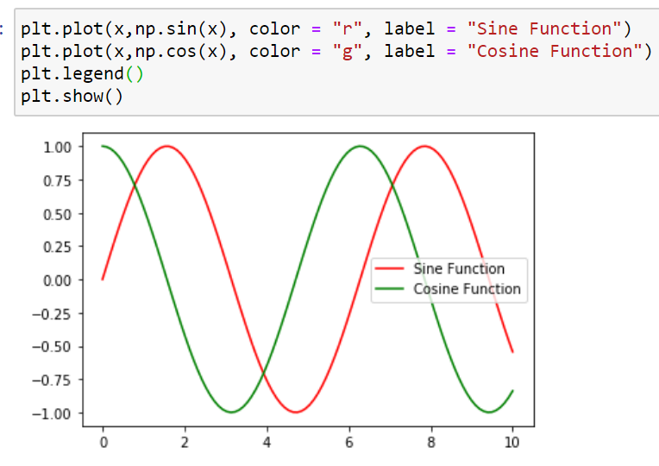
Adjusting Plots:
Adding Legends
Method:
plt.legend()

Slide 28
Hands-On

Slide 29
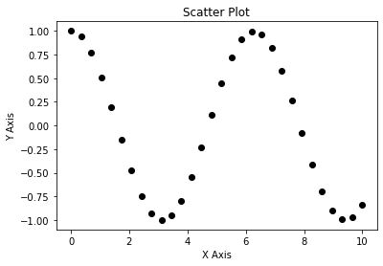
Scatter Plot

Slide 30
Scatter Plot
A Scatter (XY) Plot has points that show the relationship between two sets of data.

Slide 31
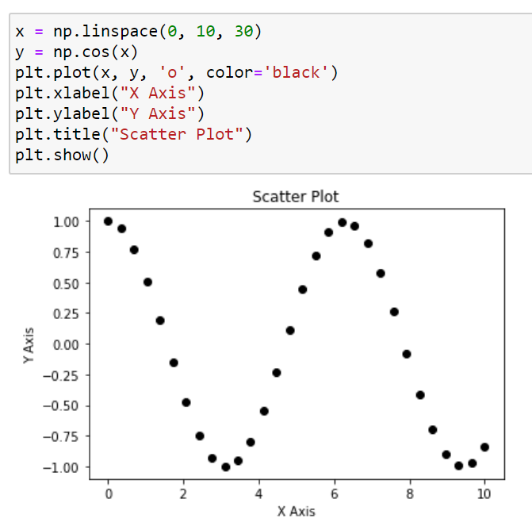
Scatter Plot
plt.plot() Method

Slide 32
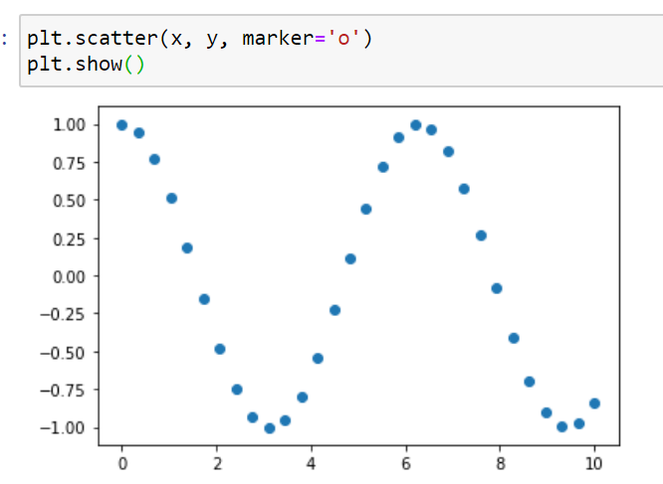
Scatter Plot

Slide 33
Hands-On

Slide 34
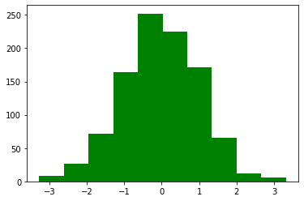
Histogram Plot

Slide 35
What is Histogram Plot ?
A histogram is a display of statistical information that uses rectangles to show the frequency of data items in successive numerical intervals of equal size.

Slide 36
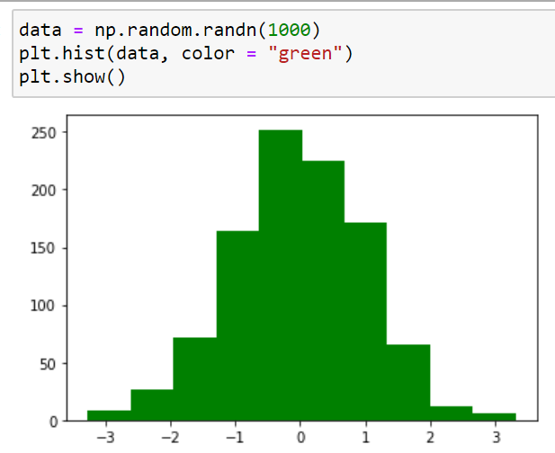
Histogram plot
Method:
plt.hist()

Slide 37
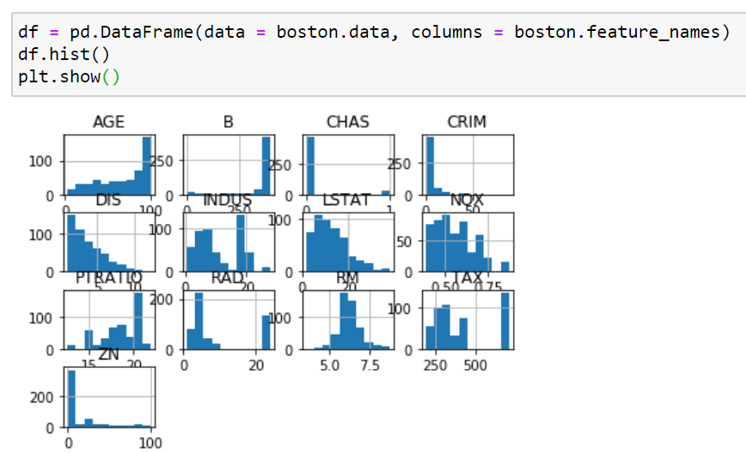
Histogram plot
On Pandas DataFrame:
df.hist()

Slide 38
Hands-On

